Slide 1

ENGINEERING CHEMISTRY
Lata Pasupulety
Department of Science and Humanities

Slide 2

ENGINEERING CHEMISTRY
Module 4- Electrochemical equilibria
Class content:
Concentration cells
Types of concentration cells
Electrolyte concentration cells
Electrode concentration cells
Ion- selective electrodes
Types of ion – selective electrodes
Electrode potential for an ion-selective electrode

Slide 3
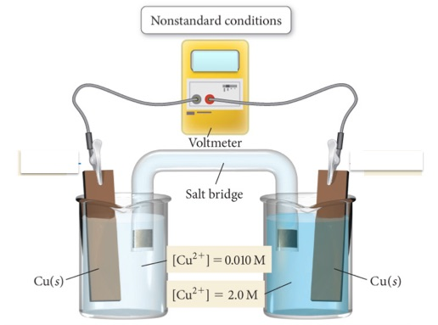
ENGINEERING CHEMISTRY
Module 4- Electrochemical equilibria
Concentration cells:
An electrochemical cell in which identical electrodes are in contact with a solution of identical species but of different concentration
https://chemdemos.uoregon.edu/demos/Voltaic-Cell-CuCu-concentration-cell-Demonstration

Slide 4
ENGINEERING CHEMISTRY
Module 4- Electrochemical equilibria
In this cell 2 copper electrodes are immersed in copper sulphate
solutions of concentration c₁ & c₂ , such that c₂> c₁
An electrolyte has spontaneous tendency to diffuse from a
solution of higher concentration to a solution of lower
concentration which is the driving force for development of
potential
Oxidation takes place at anode and reduction takes place
at cathode
e.g.,Cu/Cu²⁺(c₁)//Cu²⁺(c₂)/Cu

Slide 5



ENGINEERING CHEMISTRY
Module 4- Electrochemical equilibria
Reactions :
At anode: Cu → Cu²⁺ (c₁)+2e⁻
At cathode: Cu²⁺ (c₂)+ 2e⁻→ Cu
Expression for cell potential:
The emf of the cell = E _{cathode} – E _{anode}
$$E_{cathode }= E^{o}+ \frac{2.303RT}{nF}\log{c_{2}}$$
$$E_{anode }= E^{o}+ \frac{2.303RT}{nF}\log{c_{1}}$$
$$E_{cell}=\left( E^{o}+ \frac{2.303RT}{nF}\log{c_{2}}\right)−\left( E^{o}+ \frac{2.303RT}{nF}\log{c_{1}}\right)$$

Slide 6
ENGINEERING CHEMISTRY
Module 4- Electrochemical equilibria
The emf of the cell is positive only if c₂ > c₁
i.e., conc of metal ion at cathode > conc. of metal ion at anode
The emf of the cell depends upon the ratio c₂/c₁
When c₂ = c₁, the emf of the cell becomes zero
During working of the cell, concentration of ions
increases at anode decreases at cathode
When current is drawn from the cell c₁ increases and
c₂ decreases
The cell can operate only as long as the
concentration terms are different

Slide 7
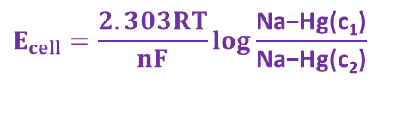
ENGINEERING CHEMISTRY
Module 4- Electrochemical equilibria
Types of concentration cells:
Electrolyte concentration cell
Electrode concentration cell
Electrolyte concentration cell:
Electrolyte concentration cell consists of two same electrodes that are dipped in the same electrolyte but with different concentrations of electrolytes
Cu/Cu²⁺(c₁)//Cu²⁺(c₂)/Cu
Cell potential is given by
Electrode concentration cell
Electrode concentration cell consists of two identical electrodes of different activity which are dipped in the same solution of electrolyte
Na-Hg(c₁)/Na⁺/Na-Hg(c₂)
Cell potential is given by
$$E_{cell}=\frac{2.303RT}{nF}\log{\frac{\text{Na}\text{−}\text{Hg}\text{(}\text{c}\text{1}\text{)}}{\text{Na}\text{−}\text{Hg}\text{(}\text{c}\text{2}\text{)}}}$$

Slide 8
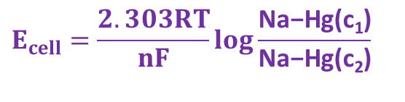
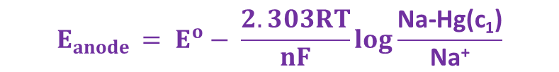

ENGINEERING CHEMISTRY
Module 4- Electrochemical equilibria
Na-Hg(c₁)/Na⁺/Na-Hg(c₂) :
Reactions are :
At anode: Na-Hg(c₁) → Na⁺ + e⁻
At cathode: Na⁺ + e⁻→ Na-Hg(c₂)
Cell potential = E _{cathode} – E _{anode}
$$E_{cathode }= E^{o}− \frac{2.303RT}{nF}\log{\frac{\text{Na}\text{−}\text{Hg}\text{(}\text{c}\text{2}\text{)}}{\text{Na}\text{+} }}$$
$$E_{anode }= E^{o}− \frac{2.303RT}{nF}\log{\frac{\text{Na}\text{−}\text{Hg}\text{(}\text{c}\text{1}\text{)}}{\text{Na}\text{+}}}$$
$$E_{cell}=\frac{2.303RT}{nF}\log{\frac{\text{Na}\text{−}\text{Hg}\text{(}\text{c}\text{1}\text{)}}{\text{Na}\text{−}\text{Hg}\text{(}\text{c}\text{2}\text{)}}}$$

Slide 9
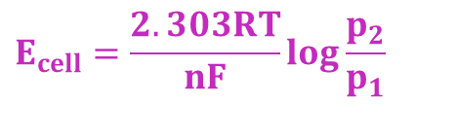
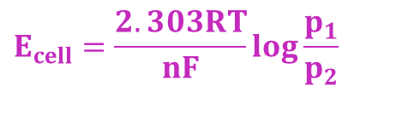
ENGINEERING CHEMISTRY
Module 4- Electrochemical equilibria
Pt/H₂(p₁ atm)/H⁺/H₂(p₂ atm)/Pt :
Nernst Equation:
Pt/Cl₂(p₁ atm)/Cl⁻/Cl₂(p₂ atm)/Pt :
Nernst Equation:
$$E_{cell}=\frac{2.303RT}{nF}\log{\frac{p_{1}}{p_{2}}}$$
$$E_{cell}=\frac{2.303RT}{nF}\log{\frac{p_{2}}{p_{1}}}$$

Slide 10
ENGINEERING CHEMISTRY
Module 4- Electrochemical equilibria
Ion selective electrodes (ISE)
Selectively respond to a specific ion in a mixture
Potential developed is a function of concentration of that ion
Have a membrane which is capable of exchanging the specific ion with solution with which it is in contact
Membrane electrodes
e.g., glass electrode

Slide 11
ENGINEERING CHEMISTRY
Module 4- Electrochemical equilibria
Types of Ion selective electrodes :
Electrodes are classified based on the membrane material
Crystalline / solid state membrane electrodes:
Single crystal LaF₃ selective to F⁻
Polycrystalline such as Ag₂S selective to S²⁻
Non-crystalline membrane electrodes:
e.g., Glass membrane selective to H⁺ , Na⁺
Liquid membrane electrodes:
An ion-exchanger is dissolved in a viscous organic liquid
membrane; used for Ca⁺, K⁺
Immobilised liquid in a rigid polymer:
e.g., immobilized ion exchanger in PVC matrix ; used for Ca⁺, NO₃⁻

Slide 12
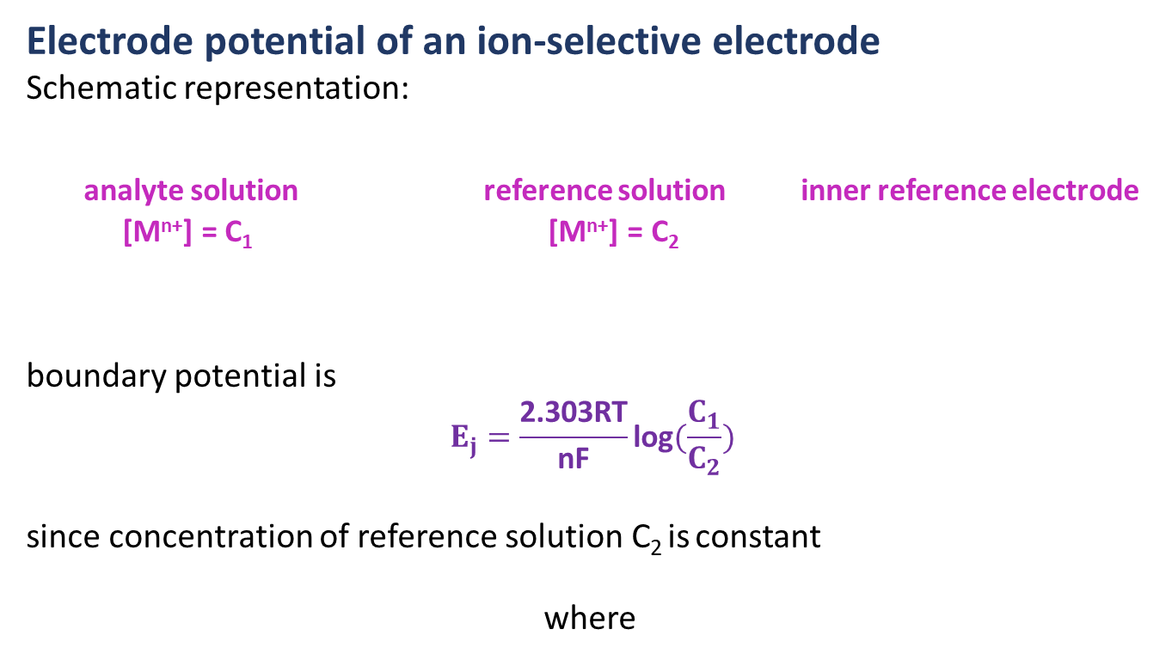

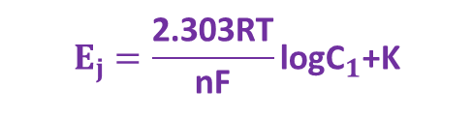
ENGINEERING CHEMISTRY
Module 4- Electrochemical equilibria
Electrode potential of an ion-selective electrode
Schematic representation:
analyte solution reference solution inner reference electrode
[M^{n+}] = C₁ [M^{n+}] = C₂
boundary potential is
$$E_{j}=\frac{\text{2.303}\text{RT}}{\text{nF}}\text{log}(\frac{C_{1}}{C_{2}})$$
since concentration of reference solution C₂ is constant
where
$$E_{j}=\frac{\text{2.303}\text{RT}}{\text{nF}}\text{log}{\text{C}}_{1}\text{+}\text{K}$$
$$\text{K}\text{= − }\frac{\text{2.303}\text{RT}}{\text{nF}}\text{log}{\text{C}}_{2}$$

Slide 13




ENGINEERING CHEMISTRY
Module 4- Electrochemical equilibria
Overall potential of the membrane electrode is given by
E_{M} = E_{j} + E_{ref}
since
$$E_{j}=\frac{\text{2.303}\text{RT}}{\text{nF}}\text{log}{\text{C}}_{1}\text{+}\text{K}$$
$$E_{M}=\frac{\text{2.303}\text{RT}}{\text{nF}}\text{log}{\text{C}}_{1}\text{+}\text{K}\text{ +}\text{Eref}$$
$$E_{M}\text{=}{{\text{E}}^{o}}_{M}+\frac{\text{2.303}\text{RT}}{\text{nF}}\text{log}{\text{C}}_{1}$$
where Eº_{M} = K + E_{ref}
At 298K,
$$E_{M}\text{=}{{\text{E}}^{o}}_{M}+\frac{0.0591}{n}\text{log}{\text{C}}_{1}$$
Membrane electrode is coupled with an external reference electrode

Slide 14

ENGINEERING CHEMISTRY
Module 4- Electrochemical equilibria
External ref. electrode/Analyte/membrane/ ref. solution/Internal ref. electrode
Cell potential = E _{cathode} – E _{anode}
E _{cell} = E _{membrane} – E _{ext.ref.electrode}
E _{cell} can be measured, E _{ext.ref.electrode} is known
E _{membrane} can be determined
Since , C₁ can be determined
The disadvantage of an ion-selective electrode is that the membrane offers very high resistance so ordinary potentiometers cannot be used; special type of potentiometers have to be used.
Applications :
Used to determine concentration of number of cations and anions such as H⁺, Li⁺,Na⁺,K⁺,Pb^{2+,}Cu²⁺,Mg²⁺,CN⁻, NO₃⁻, F⁻etc
$$E_{M}\text{=}{{\text{E}}^{o}}_{M}+\frac{0.0591}{n}\text{log}{\text{C}}_{1}$$

Slide 15
THANK YOU
Lata Pasupulety
Department of Science and Humanities
latapasupulety@pes.edu
+91 80 6666 3333 Extn 759

